Slide 1
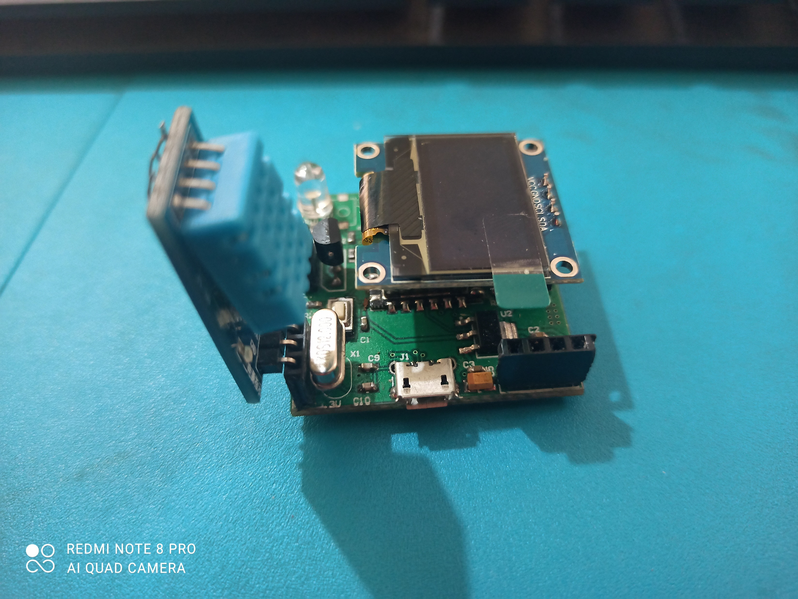
EasyIoTPiCo
Yogesh M Iggalore

Slide 2
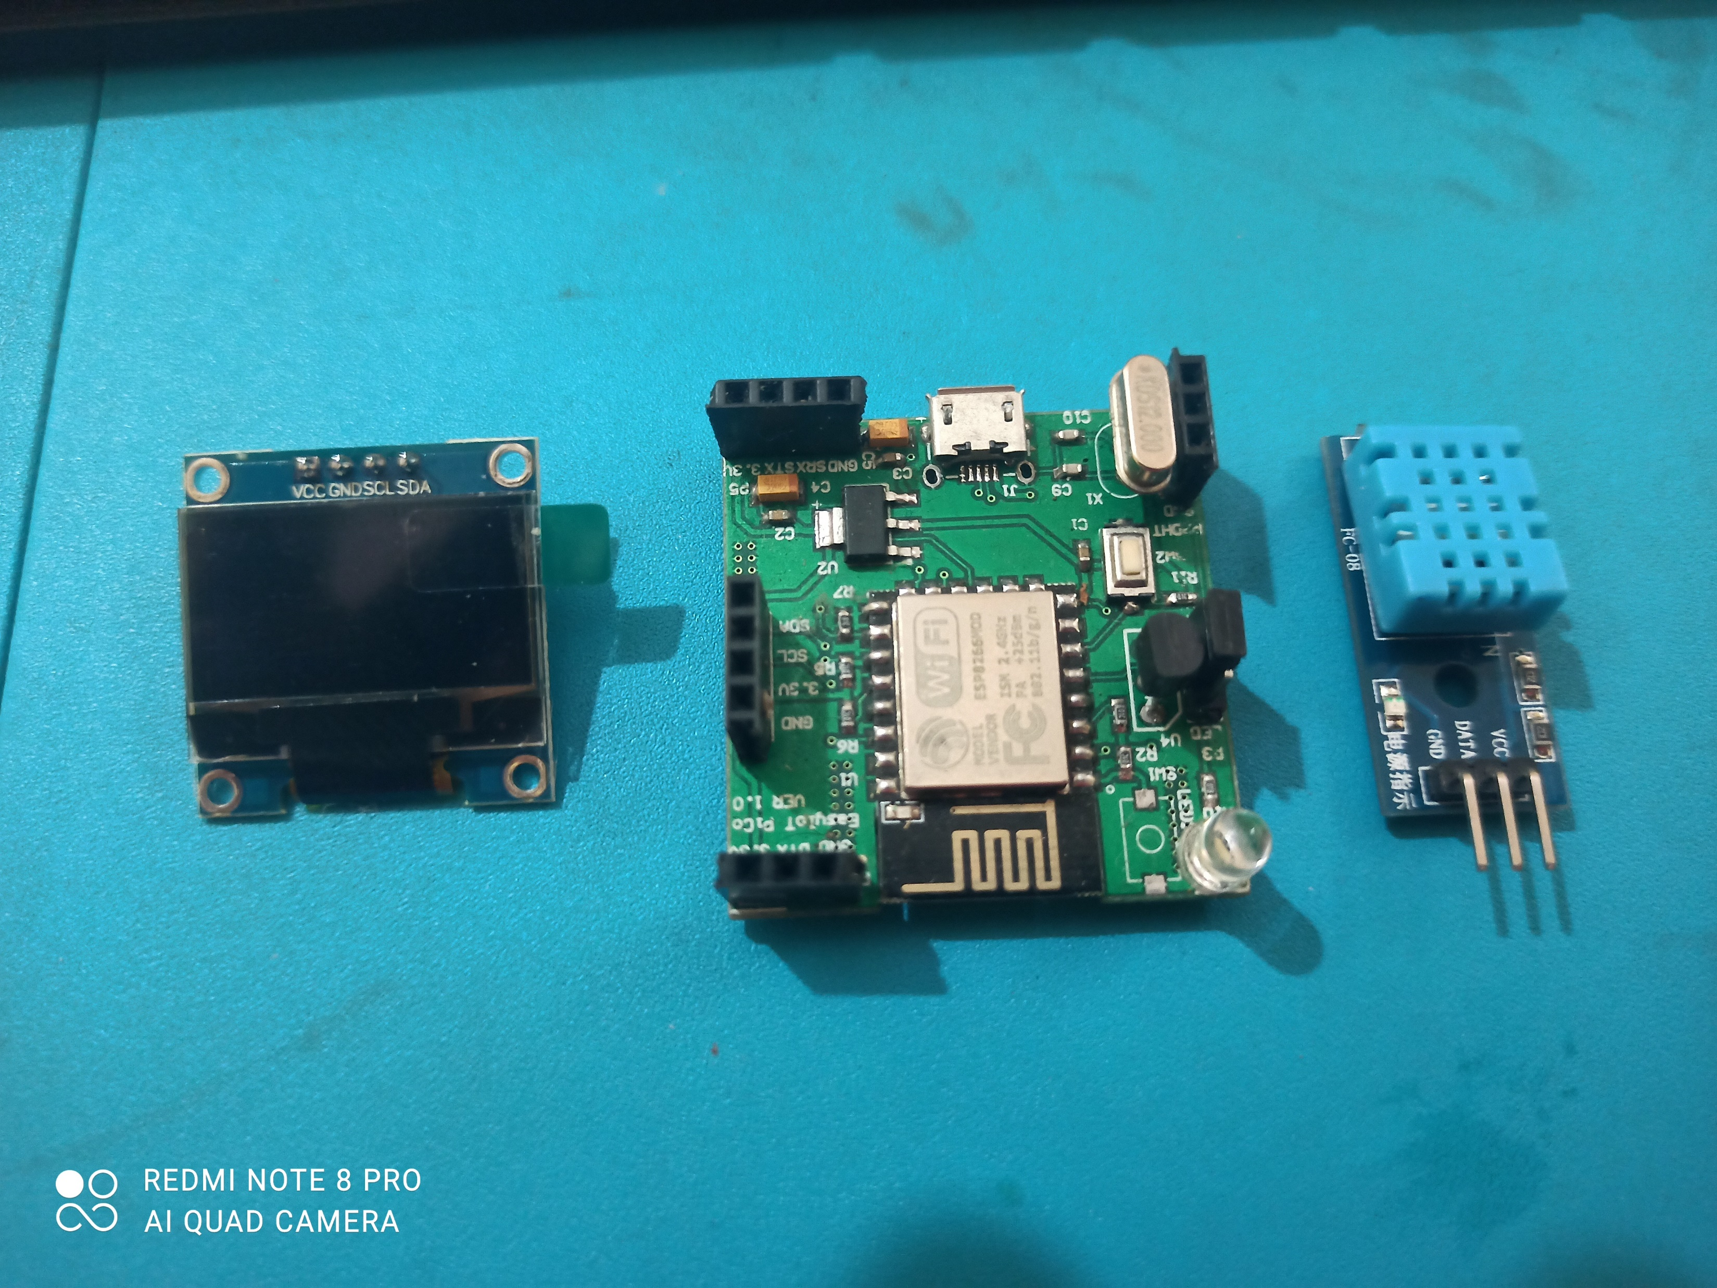
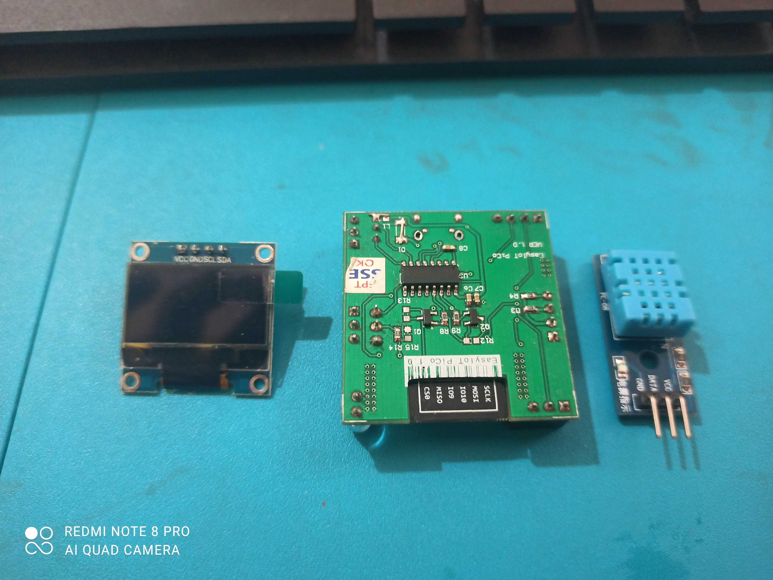
EasyIoTPiCo board

Slide 3
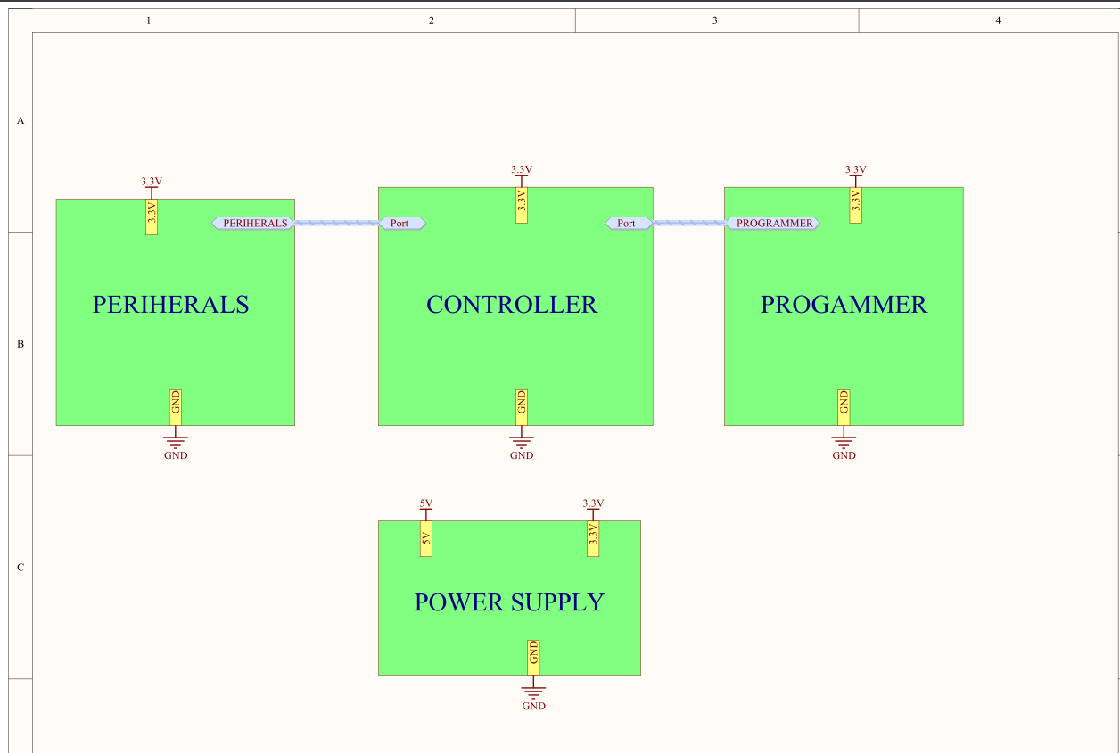

Slide 4
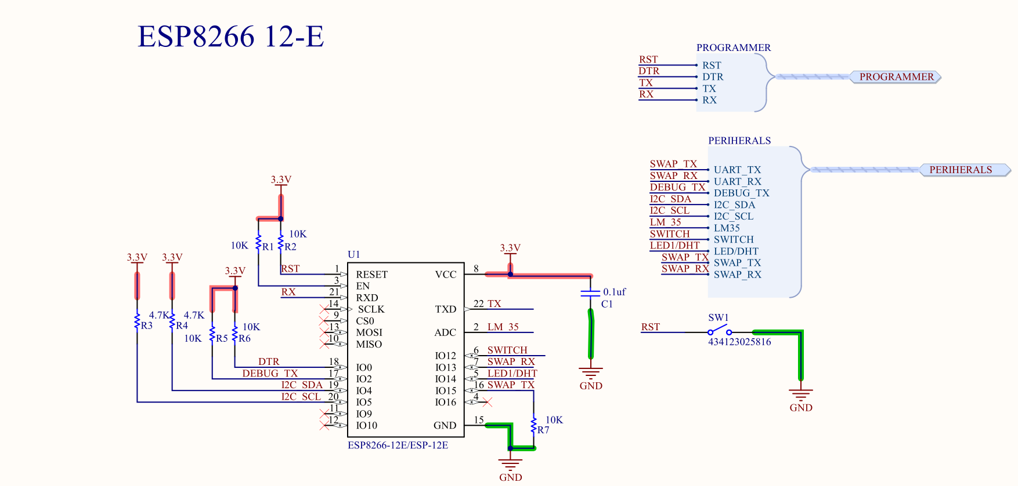

Slide 5
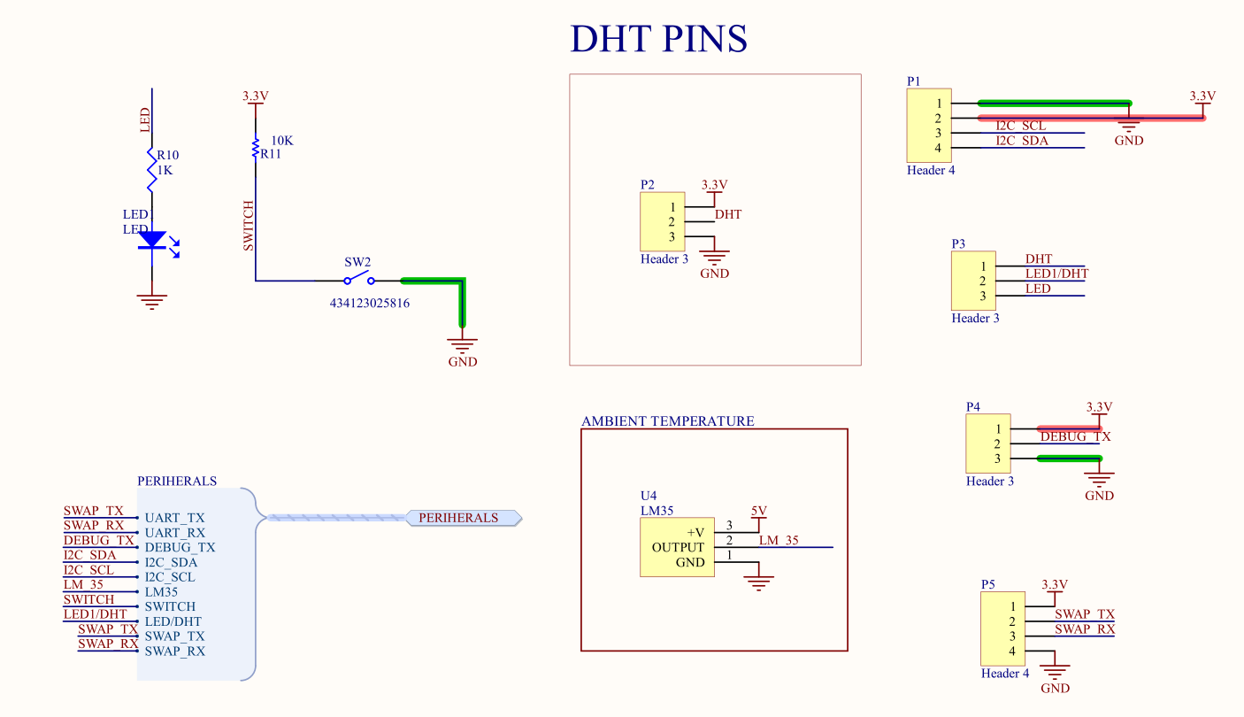

Slide 6
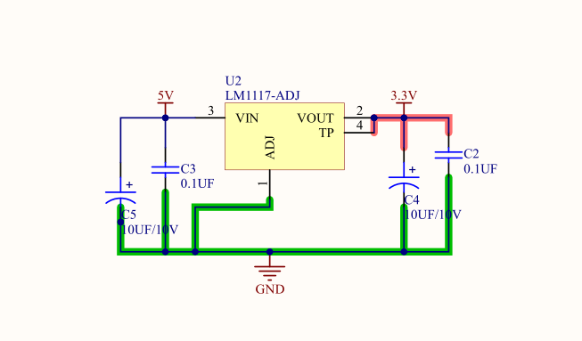

Slide 7
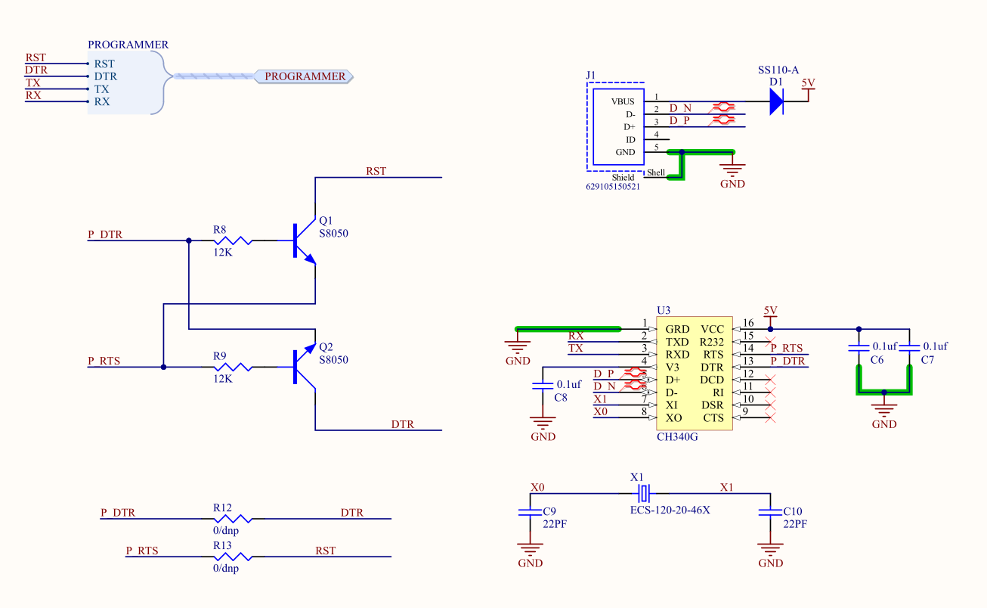

Slide 8
Contact info
Email: yogeshiggalore@gmail.com
Yogeshineclat@gmail.com
Linkedin: https://www.linkedin.com/in/yogesh-m-iggalore-38b41470/
Github: https://github.com/yogeshiggalore
Ph: +91 9900022929

Slide 9
EasyIoTPiCo-003 LED Blink example

